Slide 1
CSCI 561 Foundations of Artificial Intelligence Lecture 5: Informed Search (Chapter 3)
FALL 2018
INSTRUCTOR: PROF. SHEILA TEJADA

Slide 2

Can submit homework multiple times before the deadline
2

Slide 3
Tree Search
BFS:
F
E
DFS:
F
E
function TREE-SEARCH(problem) return a solution or failure
frontier ← MAKE-QUEUE(MAKE-NODE(problem.INITIAL-STATE))
loop do
if EMPTY?(frontier) then return failure
node ← REMOVE-FIRST(frontier)
if problem.GOAL-TEST applied to node.STATE succeeds
then return SOLUTION(node)
frontier← INSERT-ALL(EXPAND(node, problem), frontier)
Tree Search may get stuck when searching graphs:
Breadth first search: may re-visit already visited states
Depth first search: may get stuck in infinite loop

Slide 4
Graph Search
function GRAPH-SEARCH(problem) return a solution or failure
frontier ← MAKE-QUEUE(MAKE-NODE(problem.INITIAL-STATE))
explored_set ← empty
loop do
if EMPTY?(frontier) then return failure
node ← REMOVE-FIRST(frontier)
if problem.GOAL-TEST applied to node.STATE succeeds
then return SOLUTION(node)
explored_set ← INSERT(node, explored_set) for each new_node in EXPAND(node, problem) do if NOT(MEMBER?(new_node, frontier)) and NOT(MEMBER?(new_node, explored_set))
then frontier ← INSERT(new_node, frontier)

Slide 5
explored_set Issues
Maintaining and checking explored_set adds cost
Required for depth-first search to avoid infinite loops
Not strictly required in breadth-first search (if there is a solution)
But worth it if many loops in search space
Needed to detect that there is no solution

Slide 6
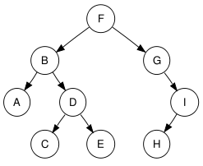
Evaluating Search Performance
Search performance is measured in four ways:
Completeness: Does it always find a solution if one exists?
Optimality: Does it always find least cost path to a solution?
Time Complexity: How long does it take to find a solution?
Space Complexity: How much memory is needed for the search?
Time and space complexity are assessed in terms of:
b - branching factor or max # of children of any node
d - depth of the least-cost solution
m - maximum depth of the search space (may be ∞)

Slide 7
Comparing Uninformed Searches
Criterion | Breadth- first | Uniform cost | Depth- first | Depth- limited | Iterative deepening | Bidirectional (if applicable)
Time | b^{d} |  | b^{m} | b^{l} | b^{d} | b^{d/2}
Space | b^{d} |  | bm | bl | bd | b^{d/2}
Complete | Yes | Yes | No | Yes If (l≥d) | Yes | Yes
Optimal | Yes | Yes | No | No | Yes | Yes
b – max branching factor of the search tree
d – depth of the least-cost solution
m – max depth of the state-space (may be infinity)
l – depth cutoff
C* is cost of optimal solution & every action costs at least ε

Slide 8
Informed Search: Best-First Search
5
12
14
17
8
5
8
12
14
17
General Idea:
Use an evaluation function for each node
Estimate of “desirability”
Expand most desirable unexpanded node.
Implementation:
QueueingFn = insert successors in decreasing order of desirability
Special cases:
Greedy Best First Search
A* search

Slide 9
Breadth First Search (again)

Slide 10
Breadth First Search (again)

Slide 11
Breadth First Search (again)

Slide 12
Breadth First Search (again)
Wrong
direction!

Slide 13
Some knowledge could help!
Suppose we knew the straight line distance (SLD) or “airline miles” from each city to Bucharest
Give nodes that move us further from goal a lower priority
SLD in traveling in Romania example
A heuristic (or estimate) of the actual cost of going to Bucharest via road
SLD is always less than or equal to the actual cost (turns out to be important)

Slide 14
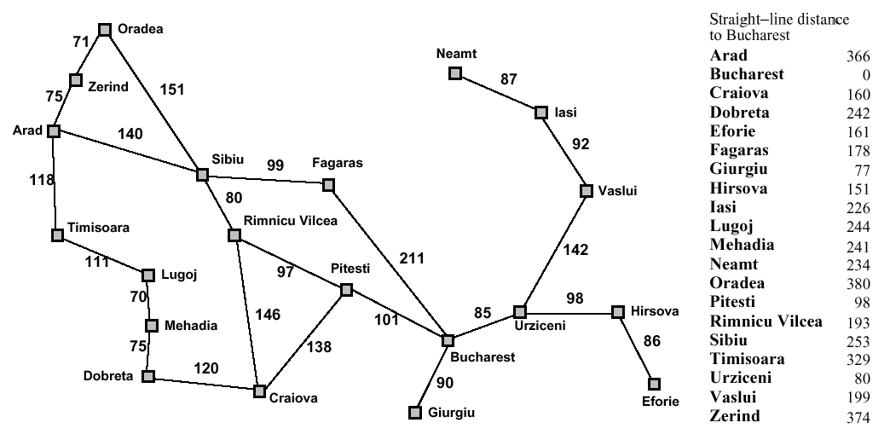
Map with SLD costs

Slide 15
Map with SLD costs

Slide 16
Map with SLD costs

Slide 17
Greedy Best First Search
Estimation function:
h(n) = estimate of cost from n to goal (heuristic)
For example:
h_{SLD}(n) = straight-line distance from n to Bucharest
Greedy BestFS keeps all the nodes generated in the Frontier, which is sorted based on h(n).
Expands first the node that appears to be closest to the goal, according to h(n).
5
12
14
17
8
5
8
12
14
17

Slide 18
Greedy Best First Search: Arad to Bucharest

Slide 19
Greedy Best First Search: Arad to Bucharest

Slide 20
Greedy Best First Search: Arad to Bucharest

Slide 21
Greedy Best First Search: Arad to Bucharest

Slide 22
Greedy Best First Search: Arad to Bucharest

Slide 23
Greedy Best-First Search Evaluation
Completeness
No, can get stuck in loops even in finite space, e.g., trying to get to Fagaras from Iasi but getting stuck in Iasi → Neamt → Iasi → Neamt…
Complete in finite space with loop check.
Optimality
No, because it only looks forward, e.g., cost to the goal, and ignores cost of reaching nodes (remember Uniform Cost Search?)
E.g., the path we just found from Arad to Bucharest is not optimal
Time complexity
Worst case for tree search is the same as depth first: O(b^{m})
Hope is that average case is much better
Space complexity
Maintains a priority queue of the fringe: O(b^{m})
Average case should be better as well

Slide 24
Greedy Best-First Search Evaluation
Completeness
No, can get stuck in loops even in finite space, e.g., trying to get to Fagaras from Iasi but getting stuck in Iasi → Neamt → Iasi → Neamt…
Complete in finite space with loop check.
Optimality
No, because it only looks forward, e.g., cost to the goal, and ignores cost of reaching nodes (remember Uniform Cost Search?)
E.g., the path we just found from Arad to Bucharest is not optimal
Time complexity
Worst case for tree search is the same as depth first: O(b^{m})
Hope is that average case is much better
Space complexity
Maintains a priority queue of the fringe: O(b^{m})
Average case should be better as well

Slide 25
Greedy Best First Search: Arad to Bucharest

Slide 26
Greedy Best-First Search Evaluation
Completeness
No, can get stuck in loops even in finite space, e.g., trying to get to Fagaras from Iasi but getting stuck in Iasi → Neamt → Iasi → Neamt…
Complete in finite space with loop check.
Optimality
No, because it only looks forward, e.g., cost to the goal, and ignores cost of reaching nodes (remember Uniform Cost Search?)
E.g., the path we just found from Arad to Bucharest is not optimal
Time complexity
Worst case for tree search is the same as depth first: O(b^{m})
Hope is that average case is much better
Space complexity
Maintains a priority queue of the fringe: O(b^{m})
Average case (e.g., with good heuristics) should be better as well

Slide 27
A* Search
General Idea
Avoid expanding paths that are already expensive
Use (approximate) total path cost to guide search
Similar to Uniform Cost Search, except use total path cost to decide where to expand
Evaluation function f(n) = g(n) + h(n)
g(n) the cost (so far) to reach the node
h(n) estimated cost to get from node to goal
f(n) estimated total cost of path through n to goal
Improvement on Greedy Best-First Search
With admissible heuristics, can guarantee optimality

Slide 28
Admissible Heuristics
A heuristic is admissible if it never overestimates the cost to reach the goal
Admissible heuristics are “optimistic”
Formally:
1. h(n) ≤ h*(n) where h*(n) is the true cost from n
2. h(n) ≥ 0, with h(G)=0 for any goal G
e.g. h_{SLD}(n) is admissible because it never overestimates the actual road distance

Slide 29
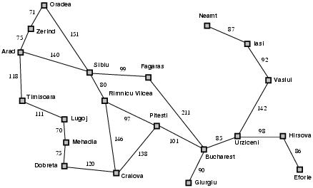
○
○

Slide 30

○
○
○

Slide 31
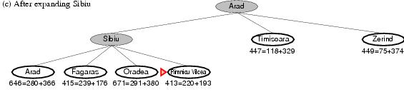
○
○
○
○

Slide 32
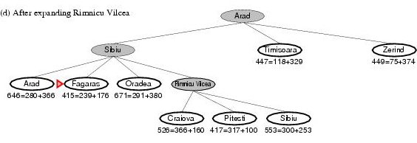
○
○
○
○

Slide 33
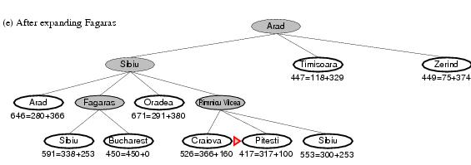
○
○
○
○

Slide 34
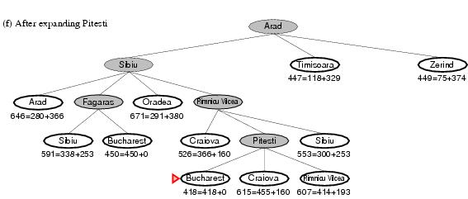
○
○
○

Slide 35
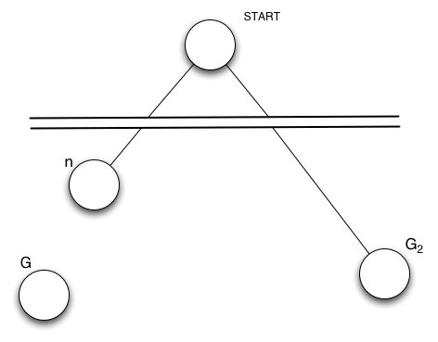
Optimality of A*: Standard Proof
n
G1
G2
Suppose suboptimal goal G₂ is in the frontier
Let n be any unexpanded node on shortest path to an optimal goal G₁
f(G₂ ) = g(G₂) since h(G₂ )=0
> g(G₁) since G₂ is suboptimal
≥ f(n) since h(n) is admissible (if f(n)>g(G₁), then we must have over estimated h(n))
Since f(G₂) > f(n), A* will never select G₂ for expansion.

Slide 36
Optimality of A*: Graph Search
Multiple paths to same state
Graph search only expand one path to this state
A* picks the path with the lowest f-cost
Admissible heuristics does not guarantee that the chosen path is optimal
Solutions:
Replace with path of lower g, similar to Uniform Cost Search
Or ensure that optimal path to any repeated state is always found before it’s expanded, with Consistency requirement
For optimality proof of A* graph search
Establish values of f(n) along any path are nondecreasing.
Establish if n is selected for expansion, the optimal path to n has been found.

Slide 37
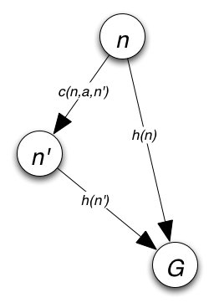
Consistency
A heuristic is consistent if for every node n and every successor n' of n generated by any action a
Form of the triangle inequality: a side of a triangle cannot be longer than the sum of the other two sides
A consistent heuristic is also admissible. It is rare for an admissible heuristic to be inconsistent.
If h is consistent, we have
That is, f(n) is nondecreasing along every path.

Slide 38
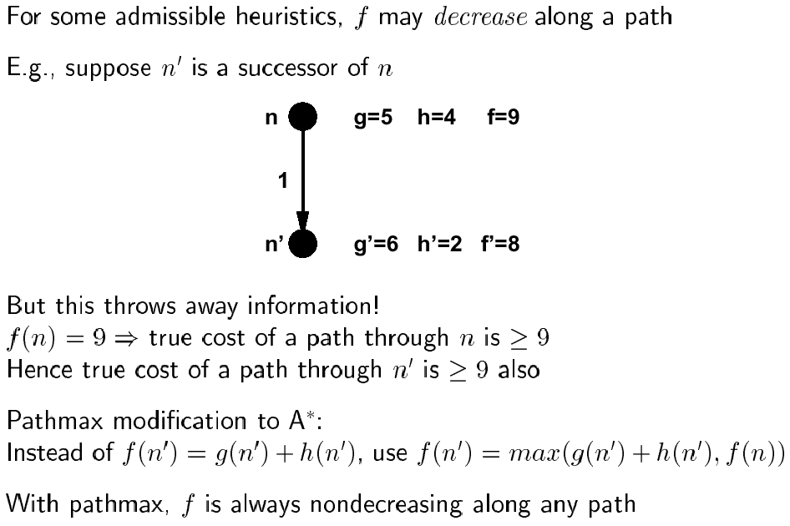
Proof of lemma: Pathmax

Slide 39
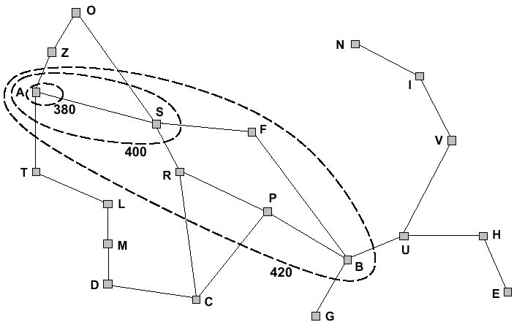
f-contours

Slide 40
f-contours
How do the contours look like when h(n) =0?

Slide 41
A* Evaluation
Completeness
YES, Unless there are infinitely many nodes with f(n) < f(G)
Optimality
YES, if admissible (Tree Search) or consistent (Graph Search)
There aren’t infinite many nodes with f(n) < f(G)
Time complexity
Exponential in [(relative error in h) x (length of solution)]
A* expands all nodes with f(n) < C* (C* is cost of optimal path)
A* expands some nodes with f(n) = C*
A* expands no nodes with f(n) > C*
Space complexity
Exponential
Keep all nodes at the bottom of the tree in memory
Still the dominant problem (rather than time complexity)

Slide 42
Memory-Bounded Heuristic Search
Alleviating A* Space problem while maintaining Completeness and Optimality
Iterative-deepening A* (IDA*)
Cutoff information is the f-cost (g+h) instead of depth
Increase to smallest f-cost of the any nodes exceeded the cutoff on previous iteration
Issues with continuous values of costs (Exercise 3.17)
Recursive best-first search (RBFS)
Recursive algorithm that attempts to mimic standard best-first search with linear space
(Simple) Memory-bounded A* ((S)MA*)
Drop the worst-leaf node when memory is full

Slide 43
Recursive Best-First Search
Search depth-first, only keep current path and branches from it in memory (saves memory over keeping entire level)
Keep track of f value (f-limit) of best sibling of path currently exploring
A
366
447
S
T
Z
393
447
449
A
F
O
R
646
415
526
413

Slide 44
Recursive Best-First Search
Search depth-first, only keep current path and branches from it in memory (saves memory over keeping entire level)
Keep track of f value (f-limit) of best sibling of path currently exploring
When current path f(n) looks worse than f-limit, backtrack, discarding tree but update f(n) on parent of discarded subtree
Expand out alternative
Return to original if it looks better subsequently
A
366
447
S
T
Z
393
447
449
447
417
415
A
F
O
R
417
646
415
526
413
450
S
B
C
P
S
591
450
526
417
553
B
C
R
418
615
607

Slide 45
RBFS Evaluation
RBFS is a bit more efficient than IDA*
Still excessive node generation, e.g., when search changes its mind about which node to explore
Like A*, optimal if h(n) is admissible
Space complexity is O(bd)
Time complexity is difficult to characterize
Depends on accuracy of h(n) and how often best path changes

Slide 46
(Simplified) Memory-Bounded A*
Use all available memory
I.e., expand best leaves until available memory is full
When full, SMA* drops worst leaf node (highest f-value)
Like RBFS, backup forgotten node value to its parent
What if all leaves have the same f-value?
Same node could be selected for expansion and deletion
SMA* solves this by expanding newest best leaf and deleting oldest worst leaf
SMA* is complete if solution is reachable, optimal if optimal solution is reachable
A solution is reachable if the path from the root to it will fit into the memory available (that is, can fit d nodes in memory)

Slide 47
How Can Knowledge Help Search?
Reduce time complexity by guiding search towards goal nodes
Pruning paths that don’t, or are unlikely to, contain goal nodes
Ordering nodes so that examine first ones that are more likely to lead to goal nodes
X
2
1
Increase chances of finding a goal node (completeness) or the best goal node or the best path to a goal node (optimality)
Reduce space complexity by reducing the size of the space traversed

Slide 48
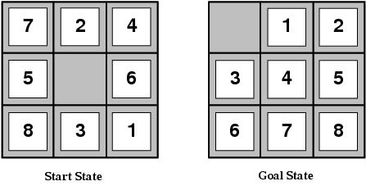
Methods of Knowledge Use
Heuristic evaluation function
Approximate measure of state quality or distance to goal
Frequently requires combining multiple component measures
Two common 8-puzzle heuristic evaluation functions
h₁ = the number of misplaced tiles
h₁(ss)=8
h₂ = the sum of the distances of the tiles from their goal positions (Manhattan Distance)
h₂(ss)=3+1+2+2+2+3+3+2=18
Primary goal is to reduce nodes visited
For 8-puzzle: with heuristics, average solution path is ~22 steps and branching factor ~3; without, it would visit ~10¹⁰ states.
But how good are they? And how do we invent them?

Slide 49
Heuristic Quality
Can quantify quality via effective branching factor b*
The branching factor that a uniform tree of depth d would have in order to contain N+1 nodes.
Measure is fairly constant for sufficiently hard problems
Can thus provide a good guide to the heuristic’s overall usefulness
An ideal value of b* would be 1

Slide 50
Some 8-Puzzle Data
1200 random problems w/ solution lengths of 2-24
Overall, h₂ looks better than h₁
But is it always better?
*
*
*
*

Slide 51
Heuristic Quality & Dominance
Heuristic h_{a} dominates h_{b} if h_{a}(n) ≥ h_{b}(n),∀n
Assuming both are admissible
h₂ dominates h₁ here by definition
E.g., Manhattan distance ≥ Tiles out of place
If one heuristic dominates another then it will never lead to expanding more nodes
In the extreme, if h=h*, only nodes along optimal solution path are expanded

Slide 52
Inventing Admissible Heuristics
Technique 1: Admissible heuristics can be derived from exact solution costs of relaxed versions of problems
A relaxed problem eliminates applicability restrictions on operators
Examples: 8-puzzle
Relaxed the rule to allow tile to move into any adjacent square (whether or not blank)
Exact solution costs in this problem yield heuristic h₂
Relaxed the rule to allow tile to move to any square in one step (whether or not blank or adjacent)
Exact solution costs in this problem yield heuristic h₁
The optimal solution cost of a relaxed problem is no greater than the optimal solution cost of the real problem

Slide 53
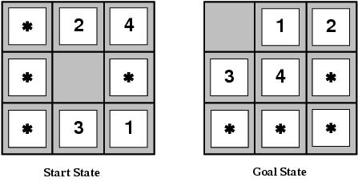
Inventing Admissible Heuristics
Technique 2: Admissible heuristics are derivable from solution costs of subproblems.
Cost of solving subproblem is a lower bound on total cost
Each subproblem defines an admissible heuristic
Maximum subproblem cost is also an admissible heuristic
And one that dominates all individual subproblem heuristics
Much more powerful for eight puzzle than Manhattan distance
Search reduction factor for fifteen puzzle of 1000

Slide 54
Inventing Admissible Heuristics
Technique 3: Discover admissible heuristics by learning from experience
Experience in this case means solving many eight puzzles

